Slide 1
Data Management
Introduction to SPSS
Dr. Manjari Agarwal

Slide 2
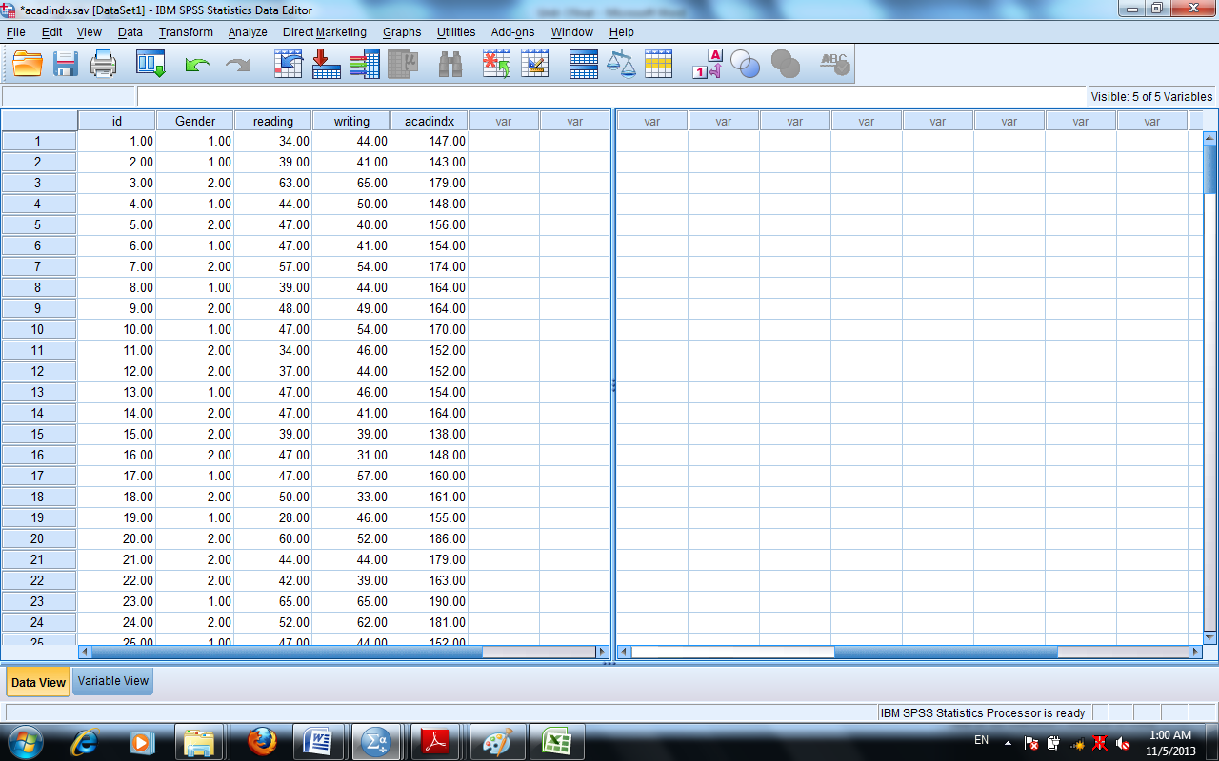
Editing Data
When a file has many variables and if you want one or two column always visible then you have to place the cursor at the bottom right of the screen, look for a small area to the right of the vertical scroll bar and drag the line to the column or variable you want to refer while entering data.

Slide 3
Managing Data Files and Data Manoeuvring
Splitting files-Split file command is useful for performing same statistical analysis on separate groups based on the values of one or more grouping variables.
Split file command has two options Compare options and organise output by groups. You can choose the options as per the requirement of research questions.
Ex: gender
By selecting Compare groups, results for both males and females will appear in the same output table.
By selecting Organize output by groups the group’s results will be displayed on two separate tables denoting one for each group.

Slide 4
Identifying Duplicate Cases
This is used to track errors in data entry ‘Identify Duplicate Command’ helps us in detecting existence of duplicate entries while feeding data into SPSS.
Further, the last column PrimaryLast is created on execution of Identify Duplicate Case as by default Last case in each group in Primary. There are two values as 0 and 1. 1 will proceed after 0 that means the 1 means the primary or unique case and 0 indicates a duplicate entry of the same case
Data from Command Menu
Identify Duplicate Cases
from drop don menu
Select the variables
post them into Define Matching Cases
Ok

Slide 5
Identifying Unusual Cases-
This function will help you in identifying unusual behaviour of samples which deviate from the group norms to which they belong to.
In this three tables would be displayed.
Anomaly index is calculated.
Anomaly Case Reason explains the reason for anomaly, impact of the variable, the value of that variable and variable norm as per the cluster behaviour. (absence of the data etc.)
Data
Identify Unusual cases
Select the Analysis variables for selecting the variables on the basis you want to perform the task
Selectthe case identifier variable
OK

Slide 6
Selecting certain cases and inserting cases
Selecting a portion of the data for analysis is frequently used by researchers. The usage of Select cases helps in selecting a subset of data for analysis. It can also perform analysis on Random Sample of Cases. For example, if you want to perform what the mean total score is for females, then you need to follow the path mentioned as under-
If then click gender mention =1 and then press continue and O.K
Further, if you want to cross check identified cases that are selected then it is easily recognisable by the diagonal line placed through the row number for the non selected cases.
If you need to insert case or variables then you can use Insert cases or Insert Variables from Edit menu in the tool bar.
Data
Select cases
If condition is satisfied
If

Slide 7
Data Aggregation
If you want to aggregate the data collected cumulatively .
This command performs arithmetic or statistical operations on similar categories of respondents. Functions like sum, maximum, mean etc. can be calculated for cases or respondents with the identical attributes.
Path:
In Break Variable you have to specify the level variable (Marks on different parameters) on which aggregation is to be performed.
Data
Break Variable
Select the variable
Browse and Select the File
Summaries of Variable
Aggregate
Function

Slide 8
Sorting cases
If you want to sort cases then you have to select a variable of interest and specify which case you want to sort in ascending or descending in the Sort Cases Window which would be located in Data Menu.

Slide 9
Merging files
The task of data entry is carried on the basis of number of questionnaires. If there are large number of questionnaires or if modules in questionnaire are divided into different data operators then the segregated data will have to be merged to get the full data set.
However, while merging you have to ensure that format files are in same data editor and identical formats are created for the each variable.
You need to ensure that matching variables have identical names and the cases or variables are in the same order.
Merging files by cases – It will be used if different operators are given different sets of full questionnaires for data entry. Here each respondent is a case. For the same you have to first access the file in which you want to merge and then you have to click Data then Merge Files and then Add Cases.
Path:
A dialogue box would appear on the screen. Variables in the New Active Dataset list box would be the list of variables in the active dataset as well as new dataset. If there are some variables in the external file which are not in the active dataset then those variables would be listed in the Unpaired Variables. After this you have to click the OK button to execute the command.
Data
Merge Files
Add Cases
An External SPSS Data File
Browse and Srlect the File
Continue

Slide 10
Merging files by Variables
It is used when there are different data entry operators enter data of different modules of questionnaire of the same set of respondents but for different questions.
Path:
A dialogue box would appear on the screen as Add variables from ………. With the name and source of your external file included in the title. The matching variables will be listed in the Excluded Variables Window and each will be followed by a “+” sign in parentheses.
Further, the variables that are in the original file that are not present in the external file are listed in the New Active Dataset Window and each one will be followed by an asterisk “*” in parentheses.
It is required that the matching variables shall be in the same order identically for both the file. You have to then click to Match Cases on Key Variables in sorted files. Select the matching variable in the box to the left click the arrow button and then, click OK.
Data
Merge Files
Add Variables
An External SPSS Data File
Browse and Select the File
Continue

Slide 11
Computing Variables
Compute variable command is used to create a new variable by doing mathematical operations or statistical operations on the existing variable. (Ex from monthly salary to annual salary)
Transform
Compute Variable
Naming target variable
Numeric expression
Continue

Slide 12
Recoding variables
This procedure also creates new variables by dividing a pre existing variable into categories and coding each category differently.
Recode into same variables
Recode into different variables
When you choose same variables then the original values would get replaced with the new recoded values. In second option both the values old and new would be available.

Slide 13
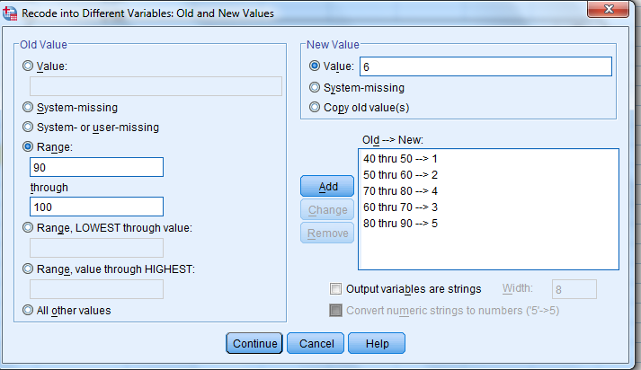

Slide 14
Automatic Recode
Automatic recode is used to convert string variables to categorical numeric variables.
Ex Stream: Commerce, Science, Arts to categorical variable 1 and 2

Slide 15
Visual Binning
It is used to convert ungrouped data into grouped data.

Slide 16
Rank Cases
This command calculates ranks and generates a new variable that shows the ranks.
Mean ranks for equal cases.

