Slide 1
Course: Introduction to SPSS for Beginners
UNIT I Introduction to SPSS, Data Management and Transformation-Creating Variables-Entering data
Course Facilitator: Dr. Manjari Agarwal

Slide 2
About SPSS
SPSS is a software package used for statistical analysis.
Statistical Package for the Social Sciences, later modified to read Statistical Product and Service Solutions.
It is now termed as “ IBM SPSS Statistics”.
At Stanford University in the late 1960s, Norman H. Nie, C. Hadlai (Tex) Hull, and Dale H. Bent developed the original software system.

Slide 3
Between 2009 and 2010, SPSS Inc. referred to its primary product lines under the PASW (Predictive Analytics SoftWare) banner, rather than referring to both the company and its products as "SPSS".

Slide 4
In addition to statistical analysis, data management (case selection, file reshaping, creating derived data) and data documentation (a metadata dictionary is stored in the data file) are features of the base software.

Slide 5
World of variables and cases
Work on SPSS begins with by defining a set of variables , then one enter data for the variables to create a number of cases.

Slide 6
Need of the Software
Planning > data collection > analysis > identify trends > reporting > produce accurate forecasts.
Survey data collated in an Excel spreadsheet, Word table, Access database can be imported to SPSS.

Slide 7
Features of SPSS
Easy to use
Covers broad range of statistical procedures.
Contains several tools for recoding data, computing variables, merging and aggregating datasets .
It is easy to learn.
It includes a full range of data management system and editing tools.
It provides in-depth statistical capabilities.
It offers complete plotting, reporting and presentation features.

Slide 8
Statistics included in the base software:
Descriptive statistics: Cross tabulation, Frequencies, Descriptive, Explore, Descriptive Ratio Statistics
Bivariate statistics: Means, t-test, ANOVA, Correlation (bivariate, partial, distances), Nonparametric tests
Prediction for numerical outcomes: Linear regression
Prediction for identifying groups: Factor analysis, cluster analysis (two-step, K-means, hierarchical), Discriminant.

Slide 9
Graphical user interface
Data View
Spreadsheet view
cases (rows) and variables (columns).
'Variable View
Each row represents a variable and shows the variable name, variable label, value label(s), print width, measurement type and a variety of other characteristics.
Views
the metadata dictionary

Slide 10
The proprietary output can be exported to text or Microsoft Word, PDF, Excel, and other formats.
Alternatively, output can be captured as data (using the OMS command), as text, tab-delimited text, PDF, XLS, HTML, XML, SPSS dataset or a variety of graphic image formats (JPEG, PNG, BMP and EMF).
SPSS can read data files created by other programmes as MS. Excel, SAS STATA, MS Access, ASCII files and .sav files created in earlier versions of SPSS.
.

Slide 11
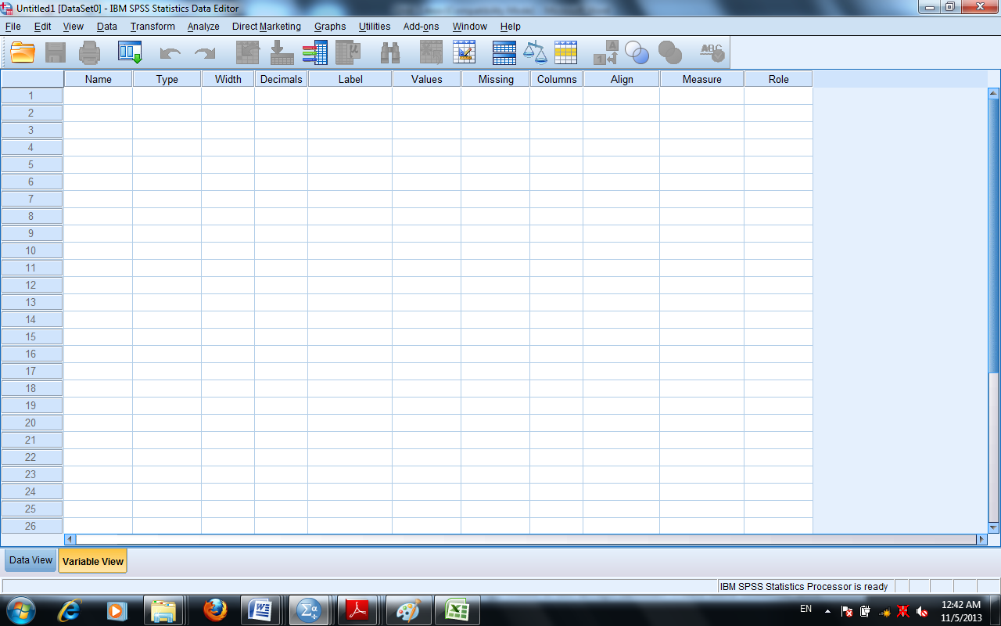
Starting SPSS
START
ALL PROGRAMS
SPSS INC STATISTICS 20.0/ 21.0
SPSS STATISTICS 20.0/21.0

Slide 12
New File Creation

Slide 14
Platforms of SPSS
In order to work with SPSS, you should have a brief idea of various interfaces of SPSS. The main interfaces are
Data Editor-.sav
The Output Window- The output -.spv
Syntax Editor-.sps
Script Editor

Slide 15
Data Editor: Tool bar and Menu bar
Tool bar
Menu Bar

Slide 16
Main Editors
Data Editor
.sav
Helps ,define, enter and edit your data and to run statistical tests.
Output Viewer
.spv
Contains the results of the statistical procedures.
Syntax
.sps
Records the sequence of the operations that are “pasted”. The windows is activated when you click on the paste function .
Script Editor

Slide 17
Tool Bar
File- It helps in creating new data file, opening existing one and save and print data file.
Edit -Allow editing functions like copying, cut, paste.
View-Shows menu editor for change in fonts, grid lines , value labels etc.
Data-Details about entering data, define variable properties. Helps in identifying duplicate cases, sorting cases, transposing, restructuring and aggregating data.
Transform-Transforms data compatible for analysis using recode, replace missing value etc.
Analyse-All inferential statistics are available. It contains statistical tools and techniques
Graphs-Builds different types of charts, graphs etc. Using chart builder
Utilities-Command which are used for more complex statistical computations
Add-ons -List extra features available for advanced level
Window-Allows you to arrange, select and control the attributes of windows
Help-Supports in gaining insights about the procedures of SPSS. Contains tutorials, coach etc.

Slide 18
Menu Bar
 | Open a particular data set |  | Insert variable/case
 | Save a particular data file |  | Split file as per groups
 | Print a particular data file |  | Insert Variable
 | Open recently used commands |  | Weight Cases
 | Redo or undo any action |  | Depicts value label
 | Go to particular case |  | Use subsets of Variable or use all variables
 | List information about the variable. Missing , label and value label etc |  | Check spelling
 | Search particular data |  | Select cases

Slide 19
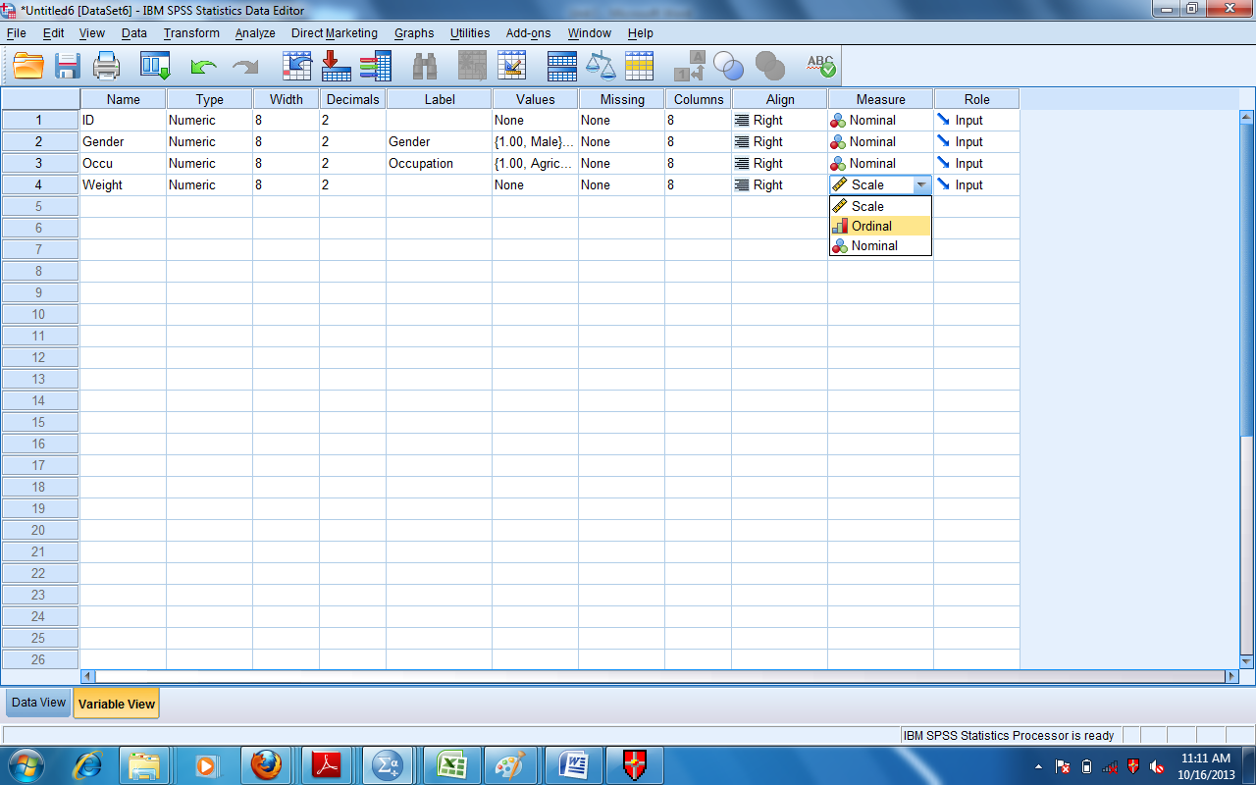
Defining Variables- In order to define variables for entering data set one have to select variable view button from bottom left corner of data editor window.

Slide 20
Variable View

Slide 21
Measure
Nominal scale- It is a measure that is used for assigning numeric values to objects in order to label them.
Don’t have any intrinsic order.
Ordinal scale- It places objects or events in order. It includes variables which are measured on likert scale or semantic differential scale.
Scale-It measures have intrinsic numeric meaning that is used for typical mathematical computations. It is default for numeric variables.
So, it includes both the Interval and Ratio Scale.

Slide 22
Variable Roles
Input | Explain whether the variable will be used as input line independent variable for regression analysis
Target | For variable to be use as dependent variable for regression analysis
Partition | Separate analysis is required for each group of categorical variable.
Split | You want file to be split on a particular categorical variable.

Slide 23
Data Management
Data plays a significant role in any research.
This part will help you in entering data, storing data, sorting data, data aggregation etc. and other related procedures.
Creating a data file
Defining variables
Entering the data
Saving Data
Inserting variables & cases-Data view and variable views, cases in between
Identifying Duplicate & Unusual cases
Sorting cases
Merging a file
Data Aggregation
Splitting file
Selecting and listing cases
Recoding the labels

Slide 24
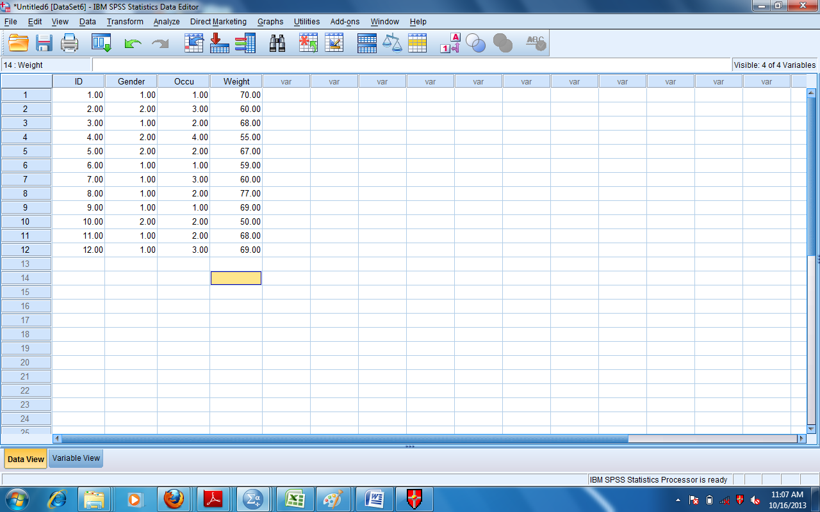
Entering Data
By Variables
By Cases

Slide 25
Once all the data is entered you can save the data file by clicking File Menu and Save and then you have to enter the name of the file and choose the location and then press save. The file will; save with an extension .sav.

Slide 26
Editing Data File-
Inserting a new case
Inserting a new variable
To copy or cut cells
To Paste cells

Slide 27
Splitting files
Split file command is useful for performing same statistical analysis on separate groups based on the values of one or more grouping variables. This command executes same statistical tests to be performed on different categories of respondents in the same dataset.
Further, when you will execute the command you have to ensure ether you select the ‘Sort the file by grouping variables’.

Slide 28
Splitting file
Compare options-results for both males and females will appear on the same output table.
Organise output by groups- results will be displayed on two separate tables, one for each group

Slide 29
Identifying Duplicate Cases and Unusual cases
This is also termed as Data Cleaning.
Frequencies followed by the two tables- Statistics and Indicator of Each Last Matching Case as Primary.
Statistics table will show the number of cases taken into consideration while finding duplicate cases.
Data from Command Menu
Identify Duplicate Cases
from drop don menu
Select the variables
post them into Define Matching Cases
Ok

Slide 30
Detect Anomaly- Three tables would be displayed in the output
Anomaly case Index List
Ratio of Group deviation index of the case to the GDI of cluster. Variance of value to the mean value of observations.
AI >2 indicates that the cases identified are unusual cases. (outliers)
Anomaly case peer list
Gives the anomalous cases
Anomaly case reason list
Anomaly Case Reason explains the reason for anomaly, impact of the variable, the value of that variable and variable norm as per the cluster behaviour.
Further, if you take the reciprocal of total number of variables used for anomaly detection and if the variable impact value is greater than the reciprocal of number of variables then the impact of this variable is said to be large. Variable norm is the average value of that variable for the cluster in which anomalous case lie.

Slide 31
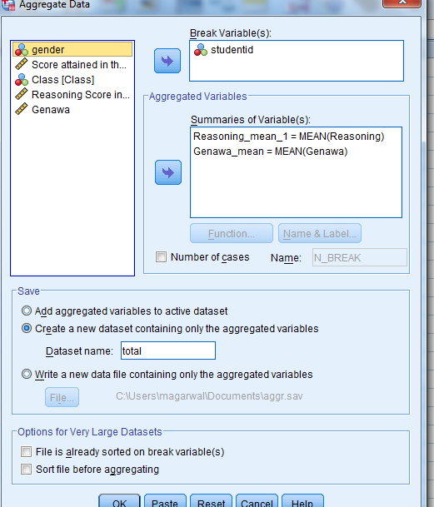
Data Aggregation
Data
Break Variable
Select the variable
Browse and Select the File
Summaries of Variable
Aggregate
Function

Slide 32
Merging files- Variable& cases
Inserting new variables and cases
Recoding Variable- Different or in same variable
Automatic recode –converts string variable into categorical variable.

Slide 33
Data can be obtained in several formats:
SPSS files
Spreadsheet - Excel, Lotus
Database - dbase, paradox
Files from other statistical programs
ASCII text
Complex database formats - Oracle, Access

Slide 34
Keep on exploring……………………….

