Slide 1
Research Method, Methodology and Research Design
By:
Dr. Jatashankar R Tewari,
Assistant Professor-Hotel Management,
Uttarakhand Open University, Haldwani

Slide 2
Research
What is Research?
“Research is a process of steps used to collect and analyze information to increase our understanding of a topic or issue”.
At a general level, research consists of three steps:
1. Pose a question
2. Collect data to answer the question
3. Present an answer to the question

Slide 3
THE SIX STEPS IN THE PROCESS OF RESEARCH
When researchers conduct a study, they proceed through a distinct set of steps. Years ago these steps were identified as the “scientific method” of inquiry (Kerlinger, 1972; Leedy & Ormrod, 2001). Using a “scientific method,” researchers:
Identify a problem that defines the goal of research
Make a prediction that, if confirmed, resolves the problem
Gather data relevant to this prediction
Analyze and interpret the data to see if it supports the prediction and resolves the question that initiated the research

Slide 4
The process of research consists of six steps:
1. Identifying a research problem
2. Reviewing the literature
3. Specifying a purpose for research
4. Collecting data
5. Analysing and interpreting the data
6. Reporting and evaluating research

Slide 5

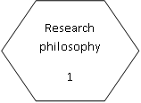
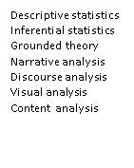


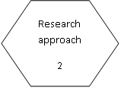

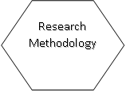
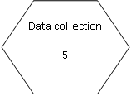
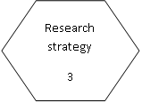


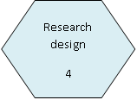
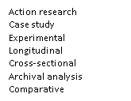

Slide 6
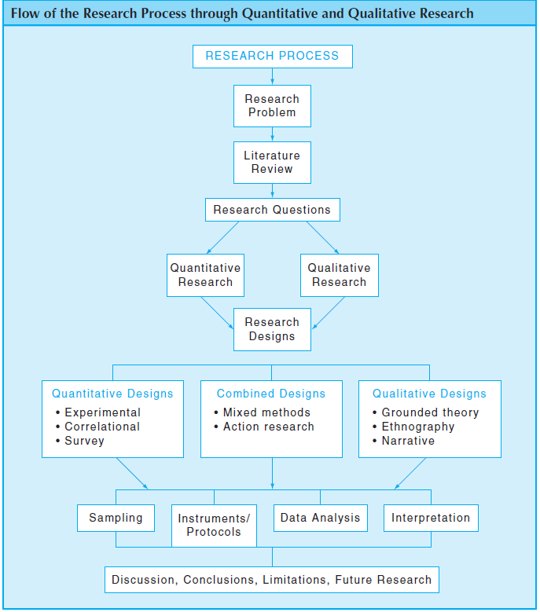

Slide 7
Quantitative Research Methods
Quantitative Research is an approach for testing objective theories by examining the relationship among variables.
These variables, in turn, can be measured, typically on instruments, so that numbered data can be analysed using statistical procedures.
The final written report has a set structure consisting of introduction, literature and theory, methods, results, and discussion.
The researcher in this form of inquiry have assumptions about testing theories deductively, building in protections against bias, controlling for alternative explanations, and being able to generalize and replicate the findings.

Slide 8
Quantitative Research haracteristics
The major characteristics of quantitative research are:
Describing a research problem through a description of trends or a need for an explanation of the relationship among variables
Providing a major role for the literature through suggesting the research questions to be asked and justifying the research problem and creating a need for the direction(purpose statement and research questions or hypotheses) of the study
Creating purpose statements, research questions, and hypotheses that are specific, narrow, measurable, and observable
Collecting numeric data from a large number of people using instruments with preset questions and responses
Analyzing trends, comparing groups, or relating variables using statistical analysis, and interpreting results by comparing them with prior predictions and past research
Writing the research report using standard, fi xed structures and evaluation criteria, and taking an objective, unbiased approach

Slide 9
Qualitative Research Method
Qualitative Research is an approach for exploring and understanding the meaning individuals or groups ascribe to a social or human problem.
The process of research involves emerging questions and procedures, data typically collected in the participant‘s setting, data analysis inductively building from particulars to general themes.
The researcher making interpretations of the meaning of the data.
The final written report has a flexible structure. The researcher in this form of inquiry support a way of looking at research that honors an inductive style, a focus on individual meaning, and the importance of rendering the complexity of a situation.

Slide 10
Qualitative Research Characteristics
In qualitative research, we see different major characteristics at each stage of the research process:
Exploring a problem and developing a detailed understanding of a central phenomenon
Having the literature review play a minor role but justify the problem
Stating the purpose and research questions in a general and broad way so as to the participants’ experiences
Collecting data based on words from a small number of individuals so that the participants’ views are obtained
Analyzing the data for description and themes using text analysis and interpreting the larger meaning of the findings
Writing the report using flexible, emerging structures and evaluative criteria, and including the researchers’ subjective reflexivity and bias

Slide 11
Mixed Methods Research
Mixed Methods Research is an approach to inquiry involving collecting both quantitative and qualitative data, integrating the two forms of data, and using distinct designs that may involve philosophical assumptions and theoretical frameworks.
The core assumption of this form of inquiry is that the combination of qualitative and quantitative approaches provides a more complete understanding of a research problem than either approach alone.

Slide 12
What is a research design?
A research design is a plan, structure and strategy of investigation so conceived as to obtain answers to research questions or problems. It includes an outline of what the investigator will do from writing the hypotheses and their operational implications to the final analysis of data. (Kerlinger, 1986)
According to Selltiz, Deutsch and Cook(1962), ‘A research design is the arrangement of conditions for collection and analysis of data in a manner that aims to combine relevance to the research purpose with economy in procedure’.
Research designs are the specific procedures involved in the research process: data collection, data analysis, and report writing.

Slide 13
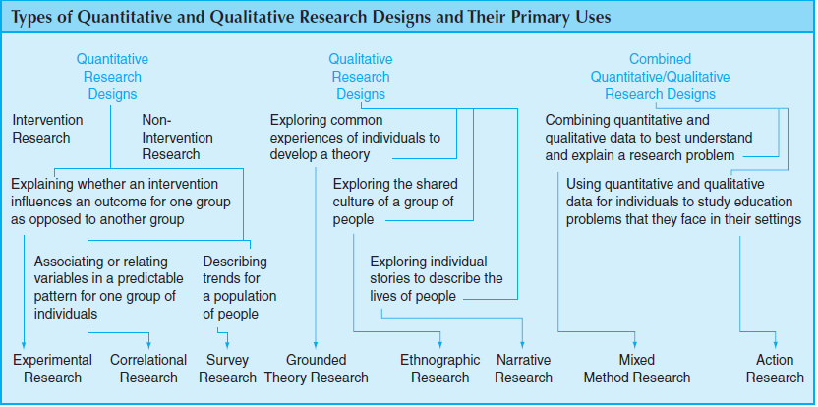
Research Designs Associated with Quantitative and Qualitative Research

Slide 14
Quantitative Research Designs
Experimental Designs: Some quantitative researchers seek to test whether an educational practice or idea makes a difference for individuals. Experimental research procedures are ideally suited for this study. Experimental designs (also called intervention studies or group comparison studies) are procedures in quantitative research in which the investigator determines whether an activity or materials make a difference in results for participants. You assess this impact by giving one group one set of activities (called an intervention) and withholding the set from another group.

Slide 15
Correlational Designs: In some studies, you may be unable to provide an intervention or to assign individuals to groups. Moreover, you focus more on examining the association or relation of one or more variables than in testing the impact of activities or materials. Correlational designs are procedures in quantitative research in which investigators measure the degree of association (or relation) between two or more variables using the statistical procedure of correlational analysis. This degree of association, expressed as a number, indicates whether the two variables are related or whether one can predict another. To accomplish this, you study a single group of individuals rather than two or more groups as in an experiment.

Slide 16
Survey Designs: In another form of quantitative research, you may not want to test an activity or materials or may not be interested in the association among variables. Instead, you seek to describe trends in a large population of individuals. In this case, a survey is a good procedure to use. Survey designs are procedures in quantitative research in which you administer a survey or questionnaire to a small group of people (called the sample) to identify trends in attitudes, opinions, behaviors, or characteristics of a large group of people(called the population).

Slide 17
Qualitative Designs
Grounded Theory Designs: Instead of studying a single group, you might examine a number of individuals who have all experienced an action, interaction, or process. Grounded theory designs are systematic, qualitative procedures that researchers use to generate a general explanation (grounded in the views of participants, called a grounded theory) that explains a process, action, or interaction among people. The procedures for developing this theory include primarily collecting interview data, developing and relating categories (or themes) of information, and composing a figure or visual model that portrays the general explanation. In this way, the explanation is “grounded” in the data from participants. From this explanation, you construct predictive statements about the experiences of individuals.

Slide 18
Ethnographic Designs: You may be interested in studying one group of individuals, in examining them in the setting where they live and work, and in developing a portrait of how they interact. An ethnographic study is well suited for this purpose. Ethnographic designs are qualitative procedures for describing, analyzing, and interpreting a cultural group’s shared patterns of behavior, beliefs, and language that develop over time. In ethnography, the researcher provides a detailed picture of the culture-sharing group, drawing on various sources of information. The ethnographer also describes the group within its setting, explores themes or issues that develop over time as the group interacts, and details a portrait of the group.

Slide 19
Narrative Research Designs: You may not be interested in describing and interpreting group behavior or ideas, or in developing an explanation grounded in the experiences of many individuals. Instead, you wish to tell the stories of one or two individuals. Narrative research designs are qualitative procedures in which researchers describe the lives of individuals, collect and tell stories about these individuals’ lives, and write narratives about their experiences. In education, these stories often relate to school classroom experiences or activities in schools.

Slide 20
Mixed Method Designs
Mixed Methods Designs: You decide to collect both quantitative data (i.e., quantifiable data) and qualitative data (i.e., text or images). The core argument for a mixed methods design is that the combination of both forms of data provides a better understanding of a research problem than either quantitative or qualitative data by itself. Mixed methods designs are procedures for collecting, analyzing, and mixing both quantitative and qualitative data in a single study or in a multiphase series of studies. In this process, you need to decide on the emphasis you will give to each form of data (priority), which form of data you will collect fi rst (concurrent or sequential), how you will “mix” the data (integrating or connecting), and whether you will use theory to guide the study (e.g., advocacy or social science theory).

Slide 21
Action Research Designs: Like mixed methods research, action research designs often utilize both quantitative and qualitative data, but they focus more on procedures useful in addressing practical problems. Action research designs are systematic procedures used by researcher to gather quantitative and qualitative data to address the problems. In case of educational research, they are focused on improvements in their educational setting, their teaching, and the learning of their students. In some action research designs, you seek to address and solve local, practical problems, such as a classroom-discipline issue for a teacher. In other studies, your objective might be to empower, transform, and emancipate individuals in educational settings.

Slide 22
Thank you

