Slide 1


Adoption of OER : An Innovative Intervention for Teaching-Learning
Manas Ranjan Panigrahi, Ph.D.
Programme officer, CEMCA, New Delhi

Slide 2









Commonwealth Educational Media Centre for Asia (CEMCA)
Established by the Commonwealth of Learning, Vancouver, Canada in 1994; Agreement with Govt. of India in 1998; Status of a Diplomatic mission in 2000
To assist governments and institutions to expand the scale, efficiency and quality of learning by using multiple media in open, distance and technology-enhanced learning

Slide 3

A Childhood riddle…
What is it that does not get reduced after sharing with someone else?
KNOWLEDGE

Slide 4

What is OER?
Teaching, learning and research materials in any medium, digital or otherwise, that reside in the public domain or have been released under an open license that permits no-cost access, use, adaptation and redistribution by others with no or limited restrictions. Open licensing is built within the existing framework of intellectual property rights as defined by relevant international conventions and respects the authorship of the work.

Slide 5
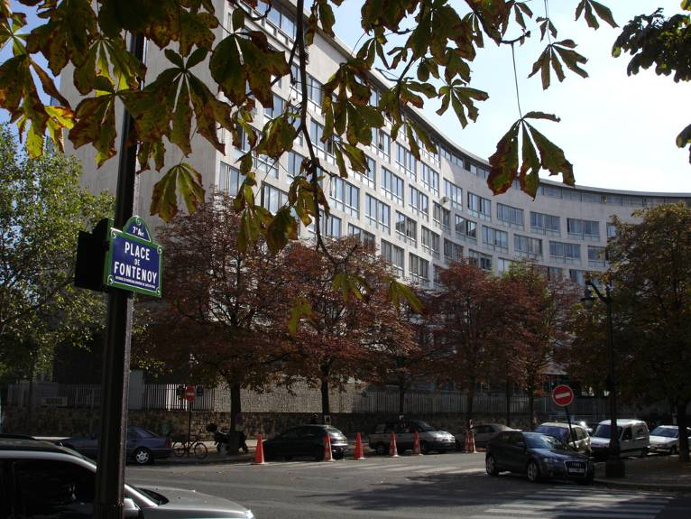
UNESCO HQ Paris
2002 Forum on the Impact of Open CourseWare
for Higher Education in Developing Countries

Slide 6
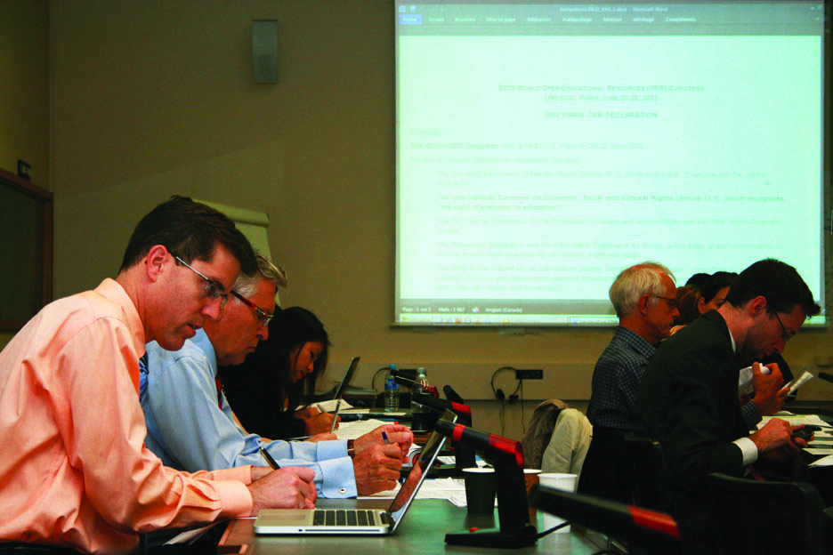

Paris Declaration on OER
Foster awareness and use of OER
Encourage the development and adaptation of OER in a variety of languages and cultural contexts
Encourage the open licensing of educational materials produced with public funds.
The 2012 Paris OER Declaration drafting group at UNESCO Headquarters, Paris, France
^{Photo: CC-BY Davide Storti}

Slide 7






OER for Inclusive and Equitable Quality Education
From Commitment to Action
2nd World OER Congress| 18-20 September, 2017 | Ljubljana, Slovenia

Slide 8
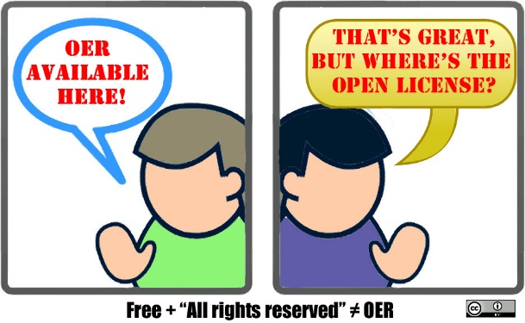

A Practical Definition of OER
Open Educational Resources (OER) are content (text, images, videos, audio, presentations etc.) with an open licence
Image source: https://flic.kr/p/r89iTe

Slide 9

Why OER?
Reduces costs
Enhance access
Improve quality

Slide 10
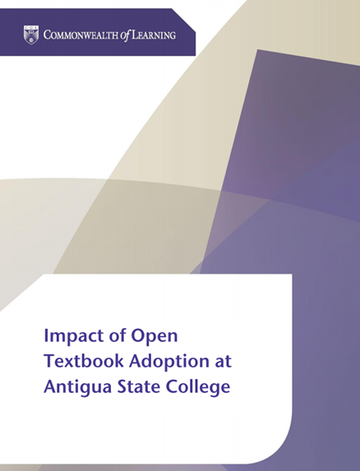
Costs: Antigua & Barbuda
Students saved between 75 to 88 ECD per course per semester by using open textbooks
Supplementing textbooks with OER improved student performance by 5.5%.

Slide 11
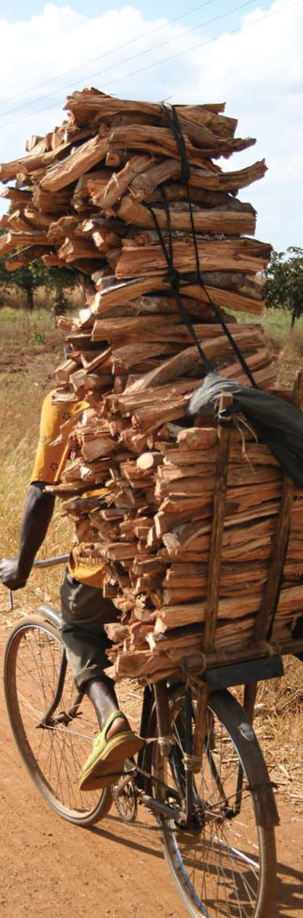
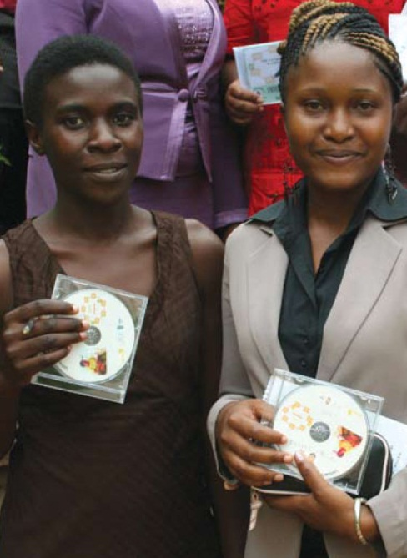
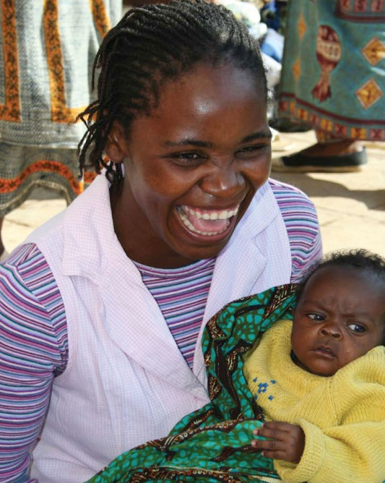

Access: Malawi
Bunda College of Agriculture
102 page Communications Skills textbook
75% OER
Adapted by adding contextually relevant
materials, activities, assignments

Slide 12
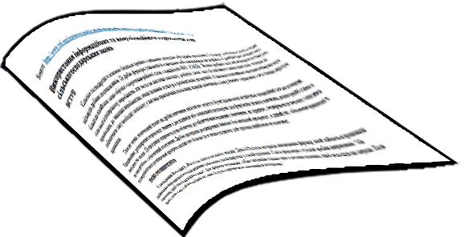


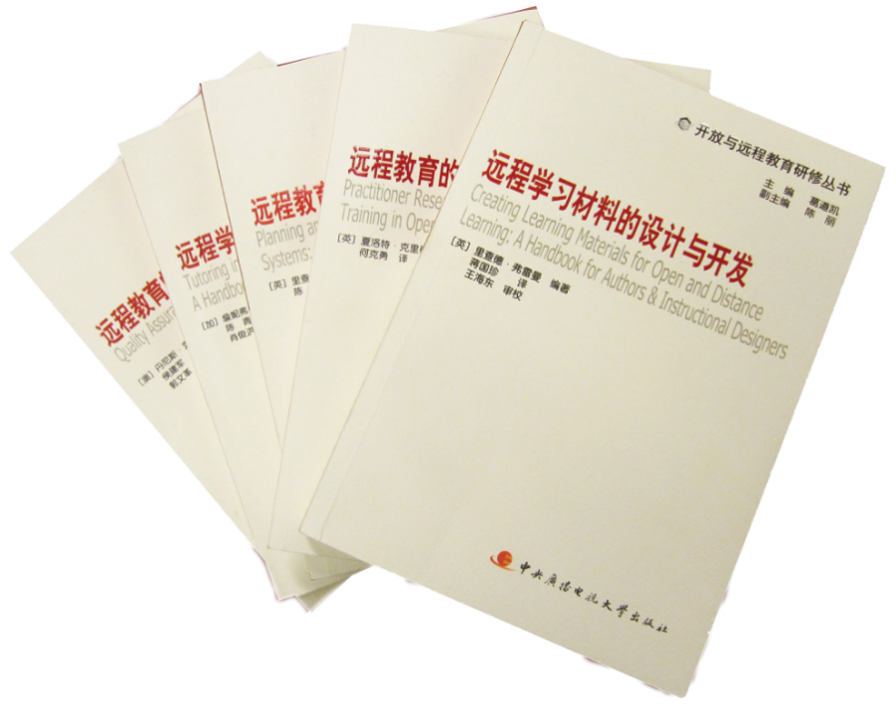
Access: Translation
COL Resources
translated and adapted by Open University of China
COL materials in Ukrainian
CORE

Slide 13



Can OER contribute to Quality?
553 institutions in India
  KSS Women’s Engineering College, Andhra Pradesh
  Maya Devi Educational Foundation, Uttarakhand
  Bhilai Institute of Technology, Chattisgarh

Slide 14

What is Open?
5R
Reuse
(copy verbatim)
Revise
(adapt and edit)
Remix
(combine with other materials)
Redistribute
(share with others)
Retain
(make, own and control copies)
It’s about open license used to share educational material
No permission required as long as the open license is respected

Slide 15
Why Consider Licensing?
Copyright and licensing issues are at the heart of OER as they have important implications for creators, users and institutions.
By default, copyright is automatic and ‘all rights reserved’ - thus permission is required by those who wish to use the work.

Slide 16

Copyright
Prohibits unauthorized use, distribution, performance, adaptation, sale, etc.
Requires permission of the Copyright holder for creating any derivative works
Fair use or fair dealing is permitted:
  Examples of fair use include commentary, search engines, criticism, news reporting, research, teaching, library archiving and scholarship.

Slide 17

Open Licences
Create more freely accessible materials
Open licences developed to make it easier for a creator to share works freely with the public.
There have been several efforts to adopt open licences:
  The Open Content Licence,
  GNU Free Documentation Licence,
  Open Publication Licence

Slide 18

Creative Commons Licenses
Creative Commons
Concepts
CC-BY
CC-BY-SA
CC-BY-NC
CC-BY-NC-SA
CC-BY-ND
CC-BY-NC-ND
Attribution
Share Alike
Non-Commercial
Non-Derivative

Slide 19
Creative Commons conditions
Condition | Explanation
Attribution (BY) | All CC licences require that others who use your work in any way must attribute it – i.e. must reference the work, giving you credit for it – the way you request, but not in a way that suggests you endorse them or their use of the work.
Non-Commercial (NC) | You let others copy, distribute, display, perform and (unless you have chosen No Derivatives) modify and use your work for any purpose other than commercially.
No Derivative works (ND) | You let others copy, distribute, display and perform only original copies of your work.
Share Alike (SA) | You let others copy, distribute, display, perform and modify your work, as long as they distribute any modified work on the same terms.

Slide 20







Open Licences- Summary
most freedom
OER
Not OER
least freedom
Notes:
20

Slide 21

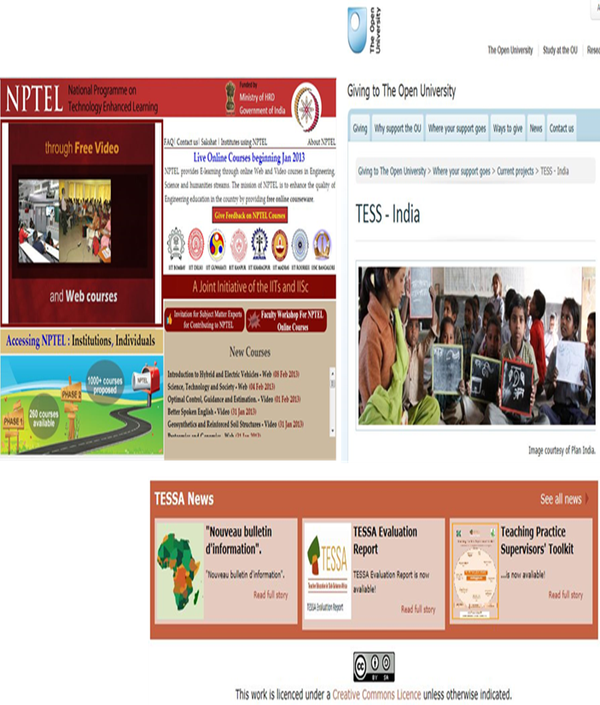
Searching OER
  Google Advanced Search
  Creative Commons Search
  JORUM (UK)
  Xpert
  Connecting Repositories
  BASE
  FreeFullPDF
  Directory of OER

Slide 22





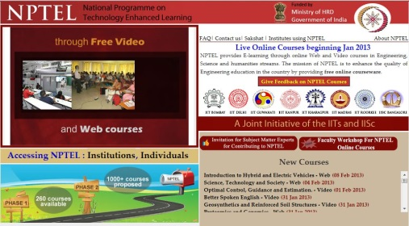




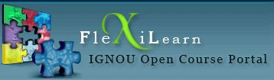
Major OER Platforms
BC Open Textbooks
Open Course Library
NPTEL
Wikipedia, Wikieducator, Wikivarsity, Wikispaces, etc.
Connexions
MIT OpenCourseware
OLI-CMU
FlexiLearn
OpenLearn
OER Commons
Directory of OER
College Open textbooks
CK-12
Siyavula
MERLOT

Slide 23

OERs…..
http://nsouoer.krc.net.in/
http://egyanagar.osou.ac.in/slm-list.php
http://epgp.inflibnet.ac.in/
http://www.ebookbou.edu.bd/
http://nroer.gov.in/welcome
http://www.sakshat.ac.in/
http://oasis.col.org/

Slide 24

Quality Assurance of OER

Slide 25

Issues in QA for OER
Who is responsible for the quality of repurposed content?
How do institutions ensure
the integrity of content?
What is the role of
QA agencies?

Slide 26
Issues specific to OER
Accessibility
Localisation
Technological barriers
Discoverability
Interoperability

Slide 27

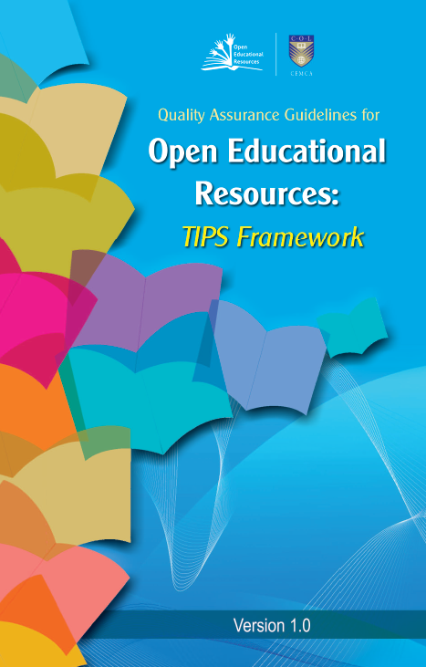
TIPS guidelines for OER creation
Present ideas to teachers as prospective creators of OER
Offering ways they could reflect upon in order to develop a culture of quality within their own respective local communities of practice
Institutions adopt these guidelines for their internal quality assurance practices
By offering these guidelines, we are interested in nurturing the ideas of quality as a culture
Development of teacher continuous professional reflection for way forward

Slide 28
TIPS Framework
The four layers of the TIPS Framework

Slide 29
Online course on OER

Slide 30


Online course on “Understanding Open Educational Resources”
Available at the COL-TEL initiative’s Moodle site.
This is a short course, and will take about 2 hours to complete.
Type this link:
https://learnoer.col.org/
Let us try to initiate……
Please mail me your certificate: mpanigrahi@col.org

Slide 31
Thank You

