Slide 1
Correlation & Regression
Dr. AKHIL CHILWAL
Teaching Assistant & Data Analyst
G.B.P.U.A. & T., Pantnagar
Mo. 9411883705

Slide 2
Pearson’s ‘r’ Correlation
Correlation is a technique for investigating the relationship between two quantitative, continuous variables.
Pearson’s Correlation Coefficient (r) is a measure of the strength of the association between the two variables.
It is a study that focuses on the strength of association or relationship between variables. If the change in our variables affects a change in the other variables then they are said to be correlated.

Slide 3
Types of Correlation
Positive / Negative
Linear /
Non-Linear
Strong / Weak

Slide 4
Positive Correlation: It means the change in the value of two variables is in the same direction i.e. if the value of ‘X’ increases, the value of ‘Y’ is also increases & if the value of ‘X’ is decreases, the value of ’Y’ is also decreases.
Example: Height & Weight of a certain group of students.
Negative Correlation: It means in the value of the variable is in the opposite direction i.e. if the value of ‘X’ increases then the value of ‘Y’ is decreases and vice versa.
Example: The high price reduces the demand of a particular commodity.

Slide 5
Linear Correlation
The correlation between two variables is said to be linear if the change of one unit in one variable result in the corresponding change in the other variable over the entire range of values.
EX:
Thus, for a unit change in the value of x, there is a constant change in the corresponding values of y.
X | 2 | 4 | 6 | 8 | 10
Y | 7 | 13 | 19 | 25 | 31

Slide 6
Non-Linear Correlation
The correlation between two variables is said to be non linear if corresponding to a unit change in one variable, the other variable does not change at a constant rate but changes at a fluctuating rate. In such cases, if the data is plotted on a graph sheet we will not get a straight line curve.

Slide 7
Strong / Weak Correlation
Correlation coefficient value | Relationship
-0.3 to +0.3 | Weak
-0.5 to -0.3 or 0.3 to 0.5 | Moderate
-0.9 to -0.5 or 0.5 to 0.9 | Strong
-1.0 to -0.9 or 0.9 to 1.0 | Very strong

Slide 8
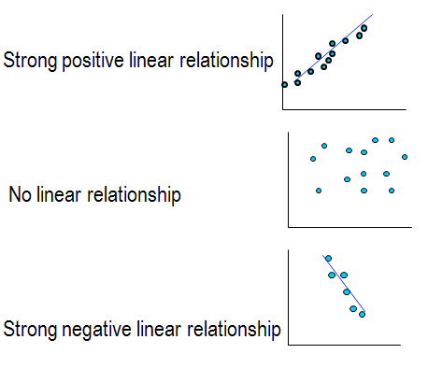
Scatterplot
Relationship between two variables
r = 0.9
r = 0.01
r = -0.9

Slide 9
Correlation Coefficient ‘r’
Y
Y
Y
X
X
Positive correlation
X
No correlation
Negative correlation

Slide 10
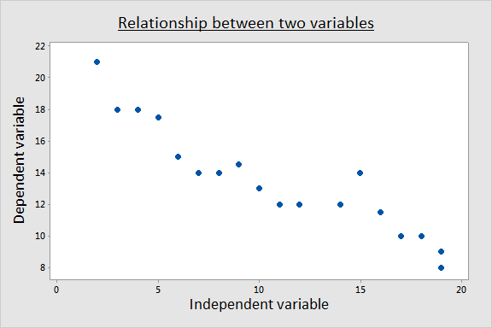
Exploring Relationships

Slide 11
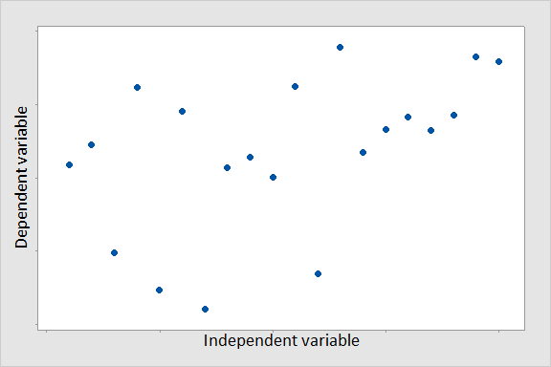
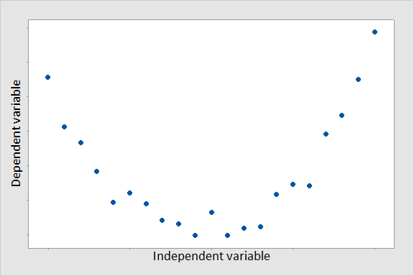
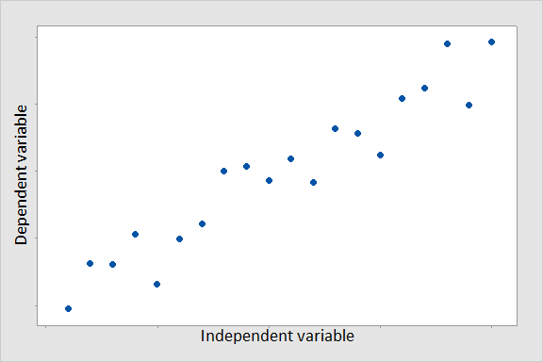
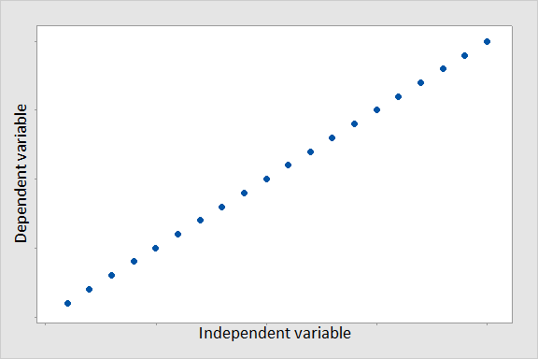
Scatter Plots

Slide 12
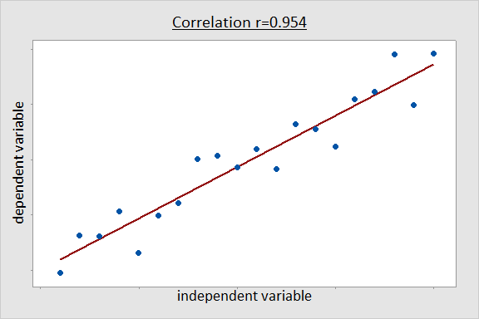
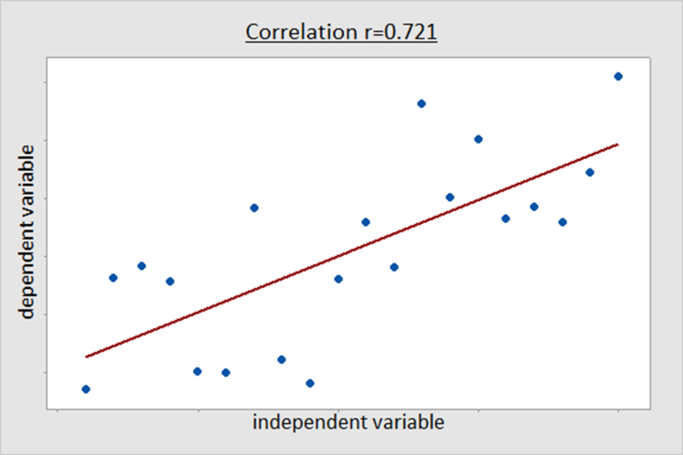
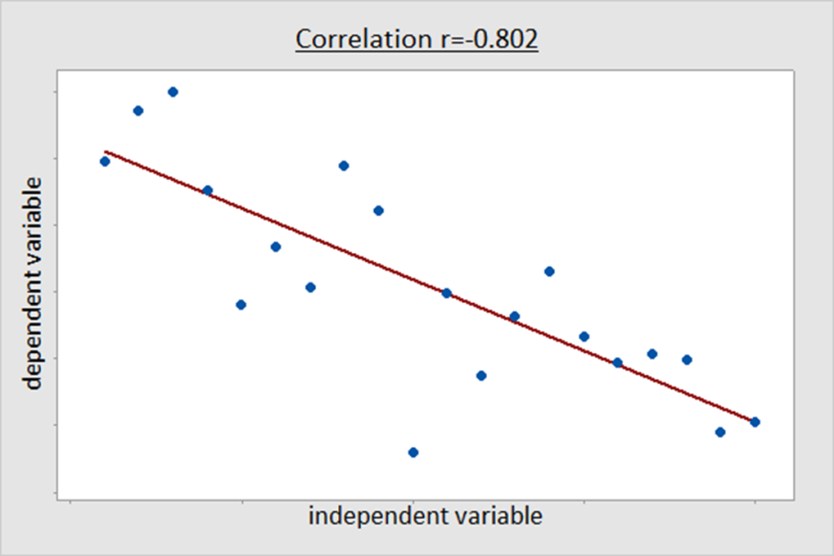
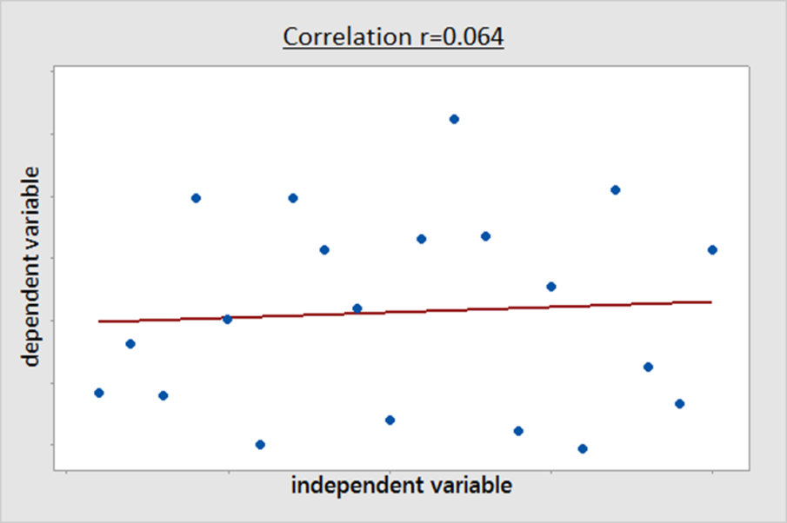
Scatter Plots

Slide 13
Karl Pearson’s Coefficient of Correlation
Correlation coefficient between two random variables X & Y, usually denoted by r(X, Y) or r_{XY}, is a numerical measure of linear relationship between them & defined as

Slide 15
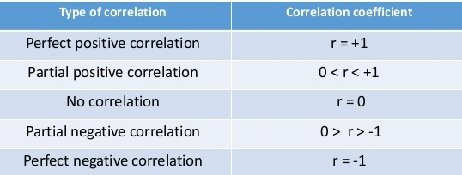

Slide 17
Regression
Regression analysis is a mathematical measure of the average relationship between two or more variables in terms of the original units of the data.
In regression analysis there are two types of variables. The variable whose value is influenced or is to be predicted is called dependent variable and the variable which influences the values or is used for prediction is called independent variable. In regression analysis independent variable is also known as regressor or predictor, while the dependent variable is also known as regressed or explained variable.

Slide 18
Dependent & Independent Variables
the independent variable is the variable which is under the investigator’s control (denoted x)
the dependent variable is the one which the investigator is trying to estimate or predict (denoted y)
can a relationship be used to predict what happens to y as x changes (ie what happens to the dependent variable as the independent variable changes)?

Slide 19
Lines of Regression
When ‘y’ is taken as dependent variables & ‘x’ is as independent variable, the equation is called regression equation of y on x.
Where ‘a’ and ‘b_{yx}’ are called regression parameters.
If we substitute the given value of ‘x’ in equation, it will give the corresponding estimated value of ‘y’.

Slide 20
When ‘x’ is taken as dependent variables & ‘y’ is as independent variable, the equation is called regression equation of X on Y.
Where ‘c’ and ‘b_{xy}’ are called regression parameters.
If we substitute the given value of ‘y’ in equation, it will give the corresponding estimated value of ‘x’.

Slide 21
Properties of Regression
The range of regression coefficient is – ∞ to + ∞
Correlation coefficient is the geometric mean between the regression coefficients.
Both regression coefficients must have the same sign. i.e., either they will positive or negative.
If one of the regression coefficients is greater than unity, the other must be less than unity.
The correlation coefficient will have the same sign as that of the regression coefficients.
Regression coefficients are independent of the change of origin but not of scale.

Slide 22
Properties of Regression
If r = 0, the variables are uncorrelated, the lines of regression become perpendicular to each other.
If r = ± 1, the two lines of regression are coincide.
The angle between the regression lines indicates the degree of dependence between the variable.
Angle between the two regression lines is
θ = tan⁻¹ (m₁- m₂ / 1+m₁m₂)
where m₁ and m₂ are the slopes of regression lines X on Y and Y on X respectively.

Slide 23
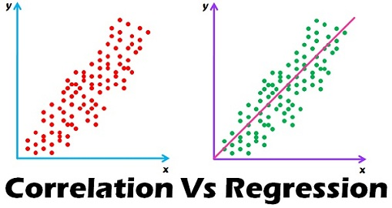
Correlation vs. Regression

Slide 24
Coefficient of Determination
r² measures the proportion of variability in one variable that can be determined from the relationship with the other variable.
A correlation of r = 0.80 means that r² ⁼ 0.64 or 64% of the variability in Y scores can be predicted from the relationship with X.

Slide 25
Compute Correlation and Regression
Problem 1:
For the following bivariate data related to two variables X and Y.
x : 23 27 28 28 29 30 31 33 35 36
y : 18 20 22 27 21 29 27 29 28 29
Problem 2:
For the following bivariate data related to two variables X and Y.
x : 13 24 29 21 24 38 33 31 36 31
y : 15 25 21 27 21 26 27 23 28 24

Slide 26
Thank You

