Slide 1
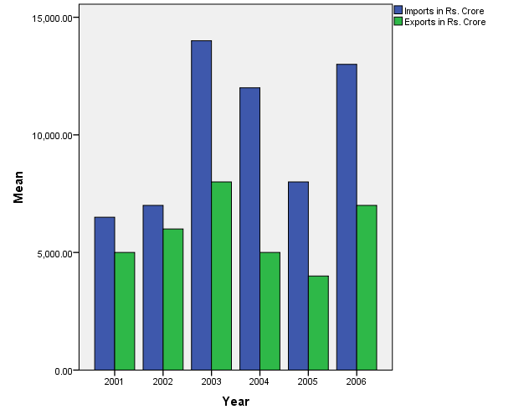
Bar Charts
Unit III

Slide 2
A bar graph or charts depicts the magnitude, sizes or the differences at equal intervals of time.
Each bar represents separate item and collectively multiple bars are displayed horizontally or vertically.
It depicts the changes in the value of the dependent variable plotted on Y-axis at discrete intervals of the independent variable on x axis.

Slide 3
This means that on x axis of the bar diagram is a discrete variable while the other axis represents a scale for one of continuous variable.
Bars are vertical lines where the lengths of the bars are proportional to their numeric values.

Slide 4
Bars can also be created as two dimensional or as percentage components bars in SPSS.

