Slide 1
LITERATURE REVIEW
Neeti Agrawal
SOMS
IGNOU

Slide 2
What is a literature review?
A text
Compilation of scholarly papers, articles..
Based on current knowledge which includes substantive findings, theoretical & methodological contributions;
Secondary sources
Not new or original work
Involves critical analysis

Slide 3
Contents of a Literature Review
Surveys
Books
Scholarly articles
Other relevant sources

Slide 4
Types of Literature Review
Narrative or Traditional literature review
Systematic literature review
Meta-analysis
Meta-synthesis
Argumentative Review
Integrative Review
Theoretical Review

Slide 5
How to conduct a Literature Review?
I Choose a topic:
E.g. GST
What exactly is required in a topic? (Research Question)
E.g. 1. Implication of GST on economy;
2. Strategic impact of GST on GDP
3. GST for a common man

Slide 6
Research Questions
Can be many….!
E.g.
What is GST?
How it works?
How will it impact the economy?
(for the first topic)

Slide 7
How to conduct a Literature Review?
Narrow down the research questions and decide the scope of the review:
How to do it?
Focus is the key….!
How many papers/articles etc. to be read?
Select the database.
Find the relevant literature.
Review.

Slide 8
How to conduct a Literature Review?
Search & Research
Take notes while reading;
Be critical and consistent
Find a logical structure

Slide 9
Need to conduct a Literature Review?
To gain in depth knowledge and the grasp of the topic;
To find the research gaps;

Slide 10
What should be an actual literature review like?
It should not be simply a description of what others have said;
Should not only be a summary;
Should have critical evaluation and ones own view points regarding the study;
Should be a blend of the analysis of the published work linked with the rationale and purpose of ones own study.

Slide 11
Purpose of literature review
Define and limit the problem;
Place the study in historical perspective;
Avoiding duplication;
Critical evaluation;
Relating the findings to previous knowledge.

Slide 12
Referencing
Giving credit to other author for their ideas and work
Necessary for avoiding plagiarism
Helps relate your arguments with literature
Included at the end of any research work

Slide 13
Citation Styles
Citation Style | Discipline
APA | Psychology, education, social sciences
MLA | Humanities
Chicago | Sciences, social sciences, humanities, history
Turabian | Humanities, social sciences, sciences
Harvard | Economics
Vancouver | Medicine

Slide 14
How to insert references in a document?

Slide 15
Go to “REFERENCES” tab in MS-word
Select the preferred referencing style. For example, we have selected APA

Slide 16
Click on ‘Insert Citation’
Select ‘Add New Source’ to open the dialogue box for creating a new reference

Slide 17
Choose a type of source from the drop-down menu

Slide 18
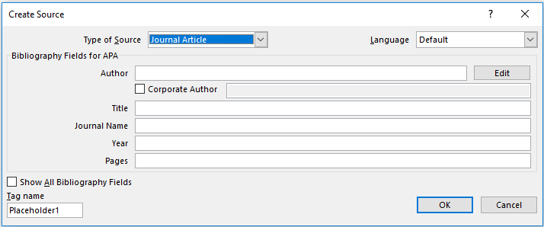
Check the button to get all fields
For example, we have selected the source as Journal Article

Slide 19
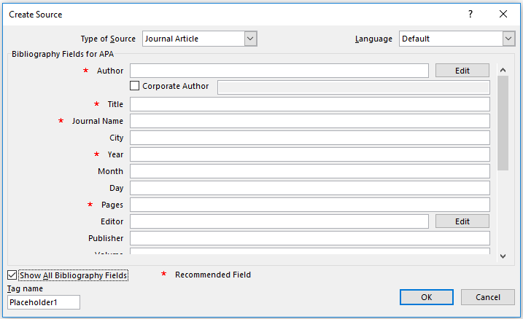
Fill in the required details for the journal article which you want to cite

Slide 20
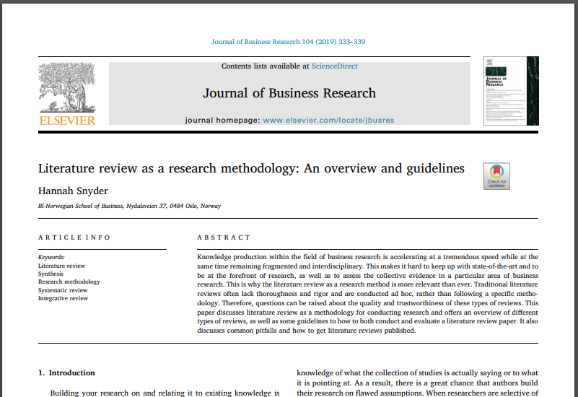
Year
Pages
Volume
Journal Name
Title
Author(s)

Slide 21
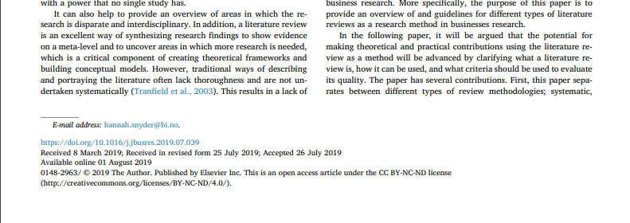
DOI
Try and find the data for all required fields included in the paper

Slide 22
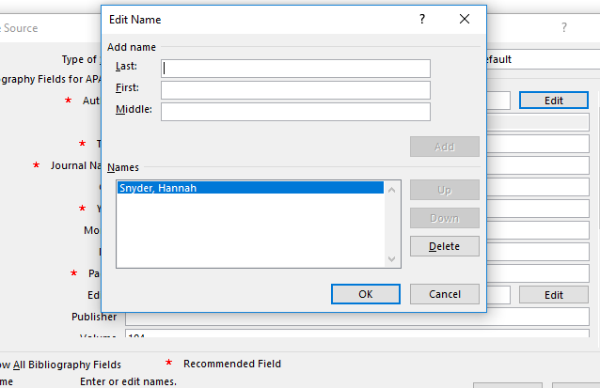
After filling the author’s name, press edit to ensure that the name appears in the following order as required in APA or the referencing style used for a particular subject area
- Last name, first name
Click OK

Slide 23
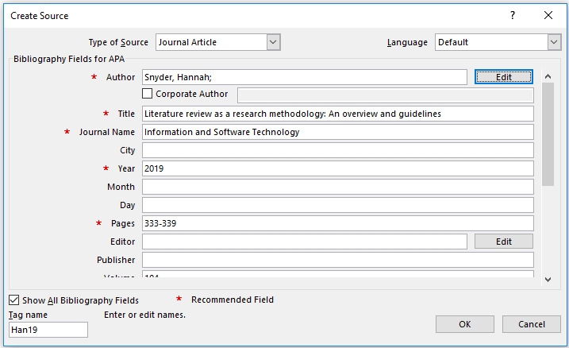
Click OK

Slide 24
Next, Click on ‘Bibliography’ to change the style of end-list of referencing
Select ‘References’ to get the reference list

Slide 25
